Slide 1
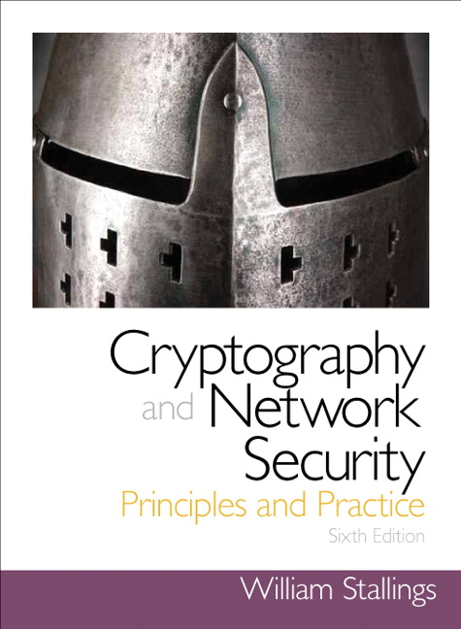
Cryptography and Network Security
Seventh Edition
by William Stallings
Notes:
Lecture slides prepared for “Cryptography and Network Security”, 7/e, by William Stallings, Chapter 11 – “Cryptographic Hash Functions”.

Slide 2
Chapter 11
Cryptographic Hash Functions
Notes:
This chapter begins with a discussion of the wide variety of applications for
cryptographic hash functions. Next, we look at the security requirements for such
functions. Then we look at the use of cipher block chaining to implement a cryptographic
hash function. The remainder of the chapter is devoted to the most important
and widely used family of cryptographic hash functions, the Secure Hash Algorithm
(SHA) family.

Slide 3
Hash Functions
A hash function H accepts a variable-length block of data M as input and produces a fixed-size hash value
h = H(M)
Principal object is data integrity
Cryptographic hash function
An algorithm for which it is computationally infeasible to find either:
(a) a data object that maps to a pre-specified hash result (the one-way property)
(b) two data objects that map to the same hash result (the collision-free property)
Notes:
A hash function H accepts a variable-length block of data M as input and produces
a fixed-size hash value h = H(M ). A “good” hash function has the property that the
results of applying the function to a large set of inputs will produce outputs that are
evenly distributed and apparently random. In general terms, the principal object of a
hash function is data integrity. A change to any bit or bits in M results, with high probability,
in a change to the hash code.
The kind of hash function needed for security applications is referred to as a
cryptographic hash function . A cryptographic hash function is an algorithm for which
it is computationally infeasible (because no attack is significantly more efficient than
brute force) to find either (a) a data object that maps to a pre-specified hash result
(the one-way property) or (b) two data objects that map to the same hash result (the
collision-free property). Because of these characteristics, hash functions are often used
to determine whether or not data has changed.

Slide 4
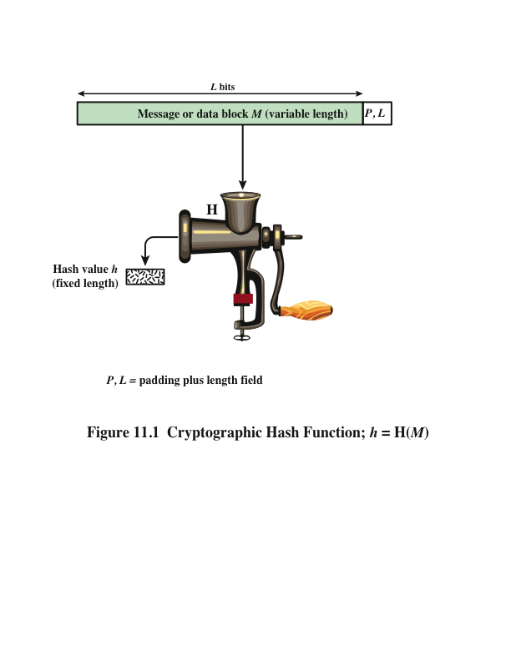
Notes:
Figure 11.1 depicts the general operation of a cryptographic hash function.
Typically, the input is padded out to an integer multiple of some fixed length
(e.g., 1024 bits), and the padding includes the value of the length of the original message
in bits. The length field is a security measure to increase the difficulty for an
attacker to produce an alternative message with the same hash value.

Slide 5
Hash Function
The main use of the hash functions is to provide message integrity.
The hash code is used to assures that data received are exactly as sent

Slide 6
Other Hash Function Uses
Commonly used to create a one-way password file
When a user enters a password, the hash of that password is compared to the stored hash value for verification
This approach to password protection is used by most operating systems
Can be used for intrusion and virus detection
Store H(F) for each file on a system and secure the hash values
One can later determine if a file has been modified by recomputing H(F)
An intruder would need to change F without changing H(F)
Can be used to construct a pseudorandom function (PRF) or a pseudorandom number generator (PRNG)
A common application for a hash-based PRF is for the generation of symmetric keys
Notes:
Hash functions are commonly used to create a one-way password file . Chapter 21
explains a scheme in which a hash of a password is stored by an operating system
rather than the password itself. Thus, the actual password is not retrievable by
a hacker who gains access to the password file. In simple terms, when a user enters
a password, the hash of that password is compared to the stored hash value
for verification. This approach to password protection is used by most operating
systems.
Hash functions can be used for intrusion detection and virus detection . Store
H(F) for each file on a system and secure the hash values (e.g., on a CD-R that is
kept secure). One can later determine if a file has been modified by recomputing
H(F). An intruder would need to change F without changing H(F).
A cryptographic hash function can be used to construct a pseudorandom
function (PRF) or a pseudorandom number generator (PRNG) . A common application
for a hash-based PRF is for the generation of symmetric keys. We discuss this
application in Chapter 12.

Slide 7
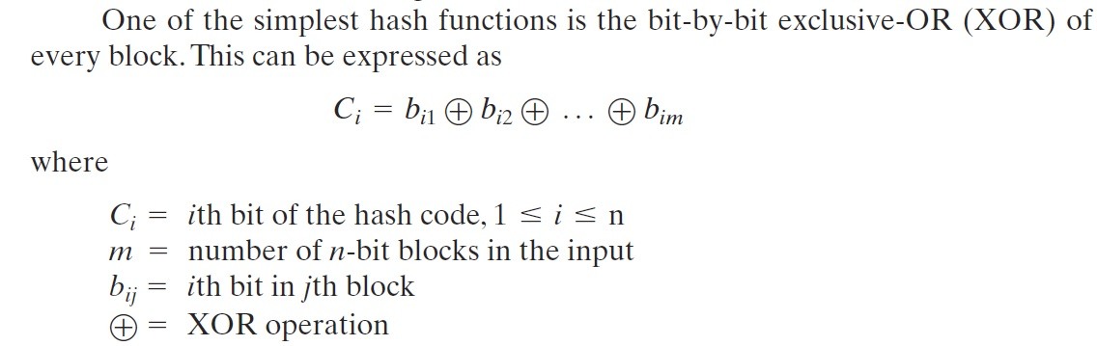
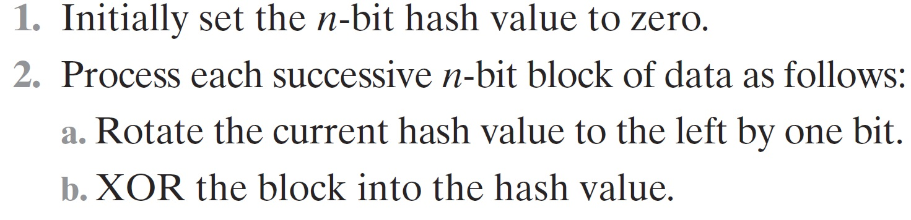
Simple Hash Functions

Slide 8
Two Simple Hash Functions
Consider two simple insecure hash functions that operate using the following general principles:
The input is viewed as a sequence of n-bit blocks
The input is processed one block at a time in an iterative fashion to produce an n-bit hash function
Bit-by-bit exclusive-OR (XOR) of every block
C_{i} = b_{i1} xor b_{i2} xor . . . xor b_{im}
Produces a simple parity for each bit position and is known as a longitudinal redundancy check
Reasonably effective for random data as a data integrity check
Perform a one-bit circular shift on the hash value after each block is processed
Has the effect of randomizing the input more completely and overcoming any regularities that appear in the input
Notes:
To get some feel for the security considerations involved in cryptographic hash functions, we present two simple, insecure hash functions in this section. One of the simplest hash functions is the bit-by-bit exclusive-OR (XOR) of every block, which can be expressed as shown. This operation produces a simple parity for each bit position and is known as a longitudinal redundancy check. It is reasonably effective for random data as a data integrity check. Each n-bit hash value is equally likely. Thus, the probability that a data error will result in an unchanged hash value is 2^{–n}. With more predictably formatted data, the function is less effective. For example, in most normal text files, the high-order bit of each octet is always zero. So if a 128-bit hash value is used, instead of an effectiveness of 2^{–128}, the hash function on this type of data has an effectiveness of 2^{–112}.
A simple way to improve matters is to perform a one-bit circular shift, or rotation, on the hash value after each block is processed. Although this second procedure provides a good measure of data integrity, it is virtually useless for data security when an encrypted hash code is used with a plaintext message. Given a message, it is an easy matter to produce a new message that yields that hash code: Simply prepare the desired alternate message and then append an n-bit block that forces the new message plus block to yield the desired hash code.

Slide 9
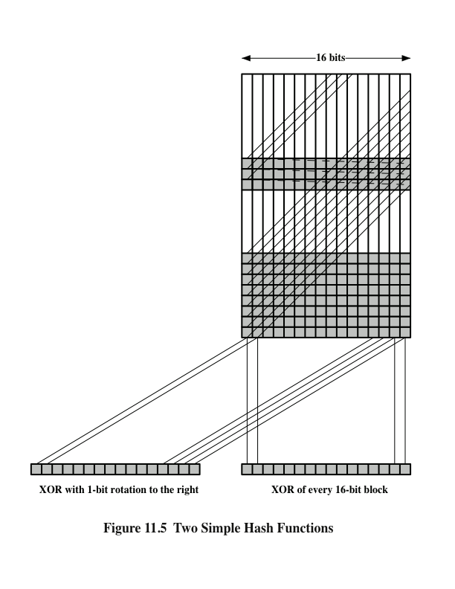
Two
Simple
Hash Functions
Notes:
Figure 11.5 illustrates these two types of hash functions for 16-bit hash values.
Although the second procedure provides a good measure of data integrity,
it is virtually useless for data security when an encrypted hash code is used with a
plaintext message, as in Figures 11.3b and 11.4a. Given a message, it is an easy matter
to produce a new message that yields that hash code: Simply prepare the desired
alternate message and then append an n -bit block that forces the new message plus
block to yield the desired hash code.
Although a simple XOR or rotated XOR (RXOR) is insufficient if only the
hash code is encrypted, you may still feel that such a simple function could be useful
when the message together with the hash code is encrypted (Figure 11.3a). But
you must be careful.

Slide 10
Requirements and Security
Preimage
Collision
x is the preimage of h for a hash value h = H(x)
Is a data block whose hash function, using the function H, is h
Because H is a many-to-one mapping, for any given hash value h, there will in general be multiple preimages
Occurs if we have x ≠ y and H(x) = H(y)
Because we are using hash functions for data integrity, collisions are clearly undesirable
Notes:
Before proceeding, we need to define two terms. For a hash value h = H(x ), we say
that x is the preimage of h . That is, x is a data block whose hash function, using the
function H, is h . Because H is a many-to-one mapping, for any given hash value h ,
there will in general be multiple preimages. A collision occurs if we have x ≠ y and
H(x ) = H(y ). Because we are using hash functions for data integrity, collisions are
clearly undesirable.

Slide 11
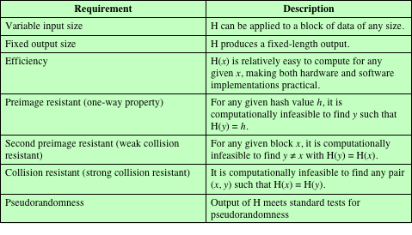
Table 11.1 Requirements for a Cryptographic Hash Function H
(Table can be found on page 323 in textbook.)
Notes:
Table 11.1 lists the generally accepted requirements for a cryptographic hash function.
The first three properties are requirements for the practical application of a
hash function.
The fourth property, preimage resistant , is the one-way property: it is easy
to generate a code given a message, but virtually impossible to generate a message
given a code. This property is important if the authentication technique involves the
use of a secret value (Figure 11.3c). The secret value itself is not sent.
The fifth property, second preimage resistant , guarantees that it is impossible
to find an alternative message with the same hash value as a given message. This
prevents forgery when an encrypted hash code is used (Figures 11.3b and 11.4a). If
this property were not true, an attacker would be capable of the following sequence:
First, observe or intercept a message plus its encrypted hash code; second, generate
an unencrypted hash code from the message; third, generate an alternate message
with the same hash code.
A hash function that satisfies the first five properties in Table 11.1 is referred
to as a weak hash function. If the sixth property, collision resistant , is also satisfied,
then it is referred to as a strong hash function. A strong hash function protects
against an attack in which one party generates a message for another party to sign.
For example, suppose Bob writes an IOU message, sends it to Alice, and she signs
it. Bob finds two messages with the same hash, one of which requires Alice to pay a
small amount and one that requires a large payment. Alice signs the first message,
and Bob is then able to claim that the second message is authentic
The final requirement in Table 11.1, pseudorandomness , has not traditionally
been listed as a requirement of cryptographic hash functions but is more or less implied.
[JOHN05] points out that cryptographic hash functions are commonly used
for key derivation and pseudorandom number generation, and that in message integrity
applications, the three resistant properties depend on the output of the hash
function appearing to be random. Thus, it makes sense to verify that in fact a given
hash function produces pseudorandom output..

Slide 12
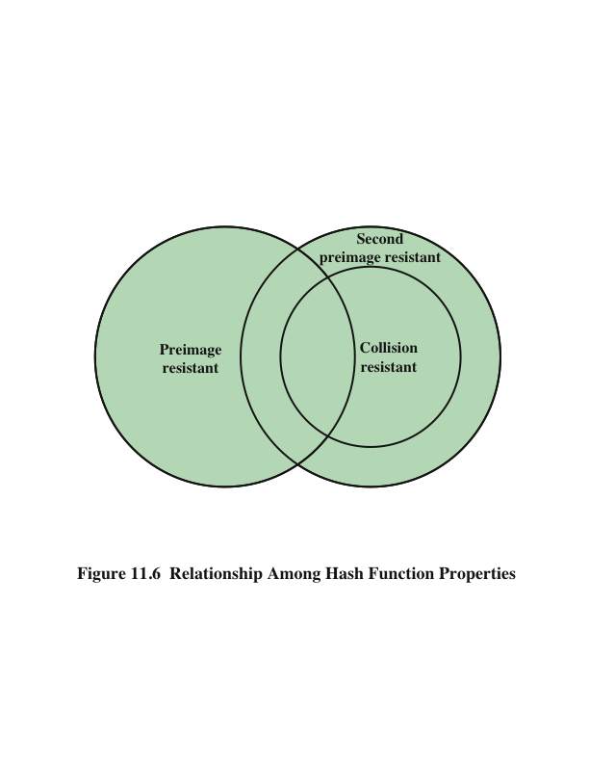
Notes:
Figure 11.6 shows the relationships among the three resistant properties.
A function that is collision resistant is also second preimage resistant, but the
reverse is not necessarily true. A function can be collision resistant but not preimage
resistant and vice versa. A function can be preimage resistant but not second
preimage resistant and vice versa. See [MENE97] for a discussion.

Slide 13
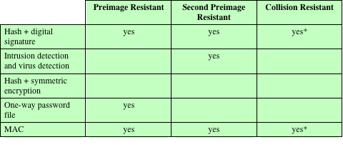
Table 11.2 Hash Function Resistance Properties Required for Various Data Integrity Applications
* Resistance required if attacker is able to mount a chosen message attack
Notes:
Table 11.2 shows the resistant properties required for various hash function
applications.

Slide 14
Attacks on Hash Functions
Brute-Force Attacks
Cryptanalysis
Does not depend on the specific algorithm, only depends on bit length
In the case of a hash function, attack depends only on the bit length of the hash value
Method is to pick values at random and try each one until a collision occurs
An attack based on weaknesses in a particular cryptographic algorithm
Seek to exploit some property of the algorithm to perform some attack other than an exhaustive search
Notes:
As with encryption algorithms, there are two categories of attacks on hash
functions: brute-force attacks and cryptanalysis. A brute-force attack does not depend
on the specific algorithm but depends only on bit length. In the case of a hash
function, a brute-force attack depends only on the bit length of the hash value. A
cryptanalysis, in contrast, is an attack based on weaknesses in a particular cryptographic
algorithm.

Slide 15
Secure Hash Algorithm (SHA)
SHA was originally designed by the National Institute of Standards and Technology (NIST) and published as a federal information processing standard (FIPS 180) in 1993
Was revised in 1995 as SHA-1
Based on the hash function MD4 and its design closely models MD4
Produces 160-bit hash values
In 2002 NIST produced a revised version of the standard that defined three new versions of SHA with hash value lengths of 256, 384, and 512
Collectively known as SHA-2
Notes:
In recent years, the most widely used hash function has been the Secure Hash
Algorithm (SHA). Indeed, because virtually every other widely used hash function
had been found to have substantial cryptanalytic weaknesses, SHA was more or
less the last remaining standardized hash algorithm by 2005. SHA was developed
by the National Institute of Standards and Technology (NIST) and published as a
federal information processing standard (FIPS 180) in 1993. When weaknesses were
discovered in SHA, now known as SHA-0, a revised version was issued as FIPS
180-1 in 1995 and is referred to as SHA-1. The actual standards document is entitled
“Secure Hash Standard.” SHA is based on the hash function MD4, and its design
closely models MD4.
SHA-1 produces a hash value of 160 bits. In 2002, NIST produced a revised
version of the standard, FIPS 180-2, that defined three new versions of SHA, with
hash value lengths of 256, 384, and 512 bits, known as SHA-256, SHA-384, and
SHA-512, respectively. Collectively, these hash algorithms are known as SHA-2 .
These new versions have the same underlying structure and use the same types of
modular arithmetic and logical binary operations as SHA-1.

Slide 16
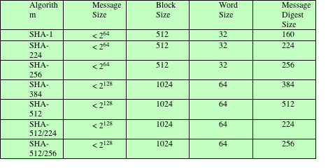
Table 11.3 Comparison of SHA Parameters
Note: All sizes are measured in bits.
Notes:
A revised document was issued as FIP PUB 180-3 in 2008, which added a 224-bit version (Table 11.3).
In 2015, NIST issued FIPS 180-4, which added two additional algorithms:
SHA-512/224 and SHA-512/256. SHA-1 and SHA-2 are also specified in RFC
6234, which essentially duplicates the material in FIPS 180-3 but adds a C code
implementation.
In 2005, NIST announced the intention to phase out approval of SHA-1
and move to a reliance on SHA-2 by 2010. Shortly thereafter, a research team described
an attack in which two separate messages could be found that deliver the
same SHA-1 hash using 2⁶⁹ operations, far fewer than the 2⁸⁰ operations previously
thought needed to find a collision with an SHA-1 hash [WANG05]. This result
should hasten the transition to SHA-2.

Slide 17
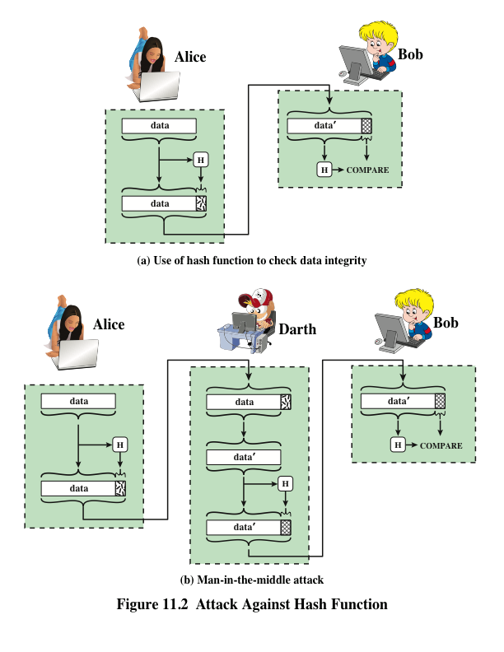
Notes:
Message authentication is a mechanism or service used to verify the integrity of
a message. Message authentication assures that data received are exactly as sent
(i.e., contain no modification, insertion, deletion, or replay). In many cases, there is
a requirement that the authentication mechanism assures that purported identity of
the sender is valid. When a hash function is used to provide message authentication,
the hash function value is often referred to as a message digest .
The essence of the use of a hash function for message authentication is as
follows. The sender computes a hash value as a function of the bits in the message
and transmits both the hash value and the message. The receiver performs the same
hash calculation on the message bits and compares this value with the incoming
hash value. If there is a mismatch, the receiver knows that the message (or possibly
the hash value) has been altered (Figure 11.2a).
The hash function must be transmitted in a secure fashion. That is, the hash
function must be protected so that if an adversary alters or replaces the message,
it is not feasible for adversary to also alter the hash value to fool the receiver. This
type of attack is shown in Figure 11.2b. In this example, Alice transmits a data block
and attaches a hash value. Darth intercepts the message, alters or replaces the data
block, and calculates and attaches a new hash value. Bob receives the altered data
with the new hash value and does not detect the change. To prevent this attack, the
hash value generated by Alice must be protected.

Slide 18
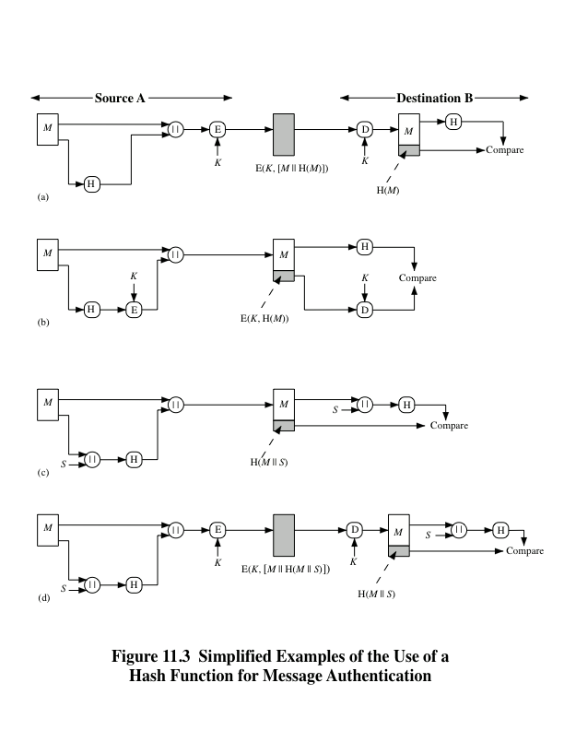
Notes:
Figure 11.3 illustrates a variety of ways in which a hash code can be used to
provide message authentication, as follows:
a. The message plus concatenated hash code is encrypted using symmetric
encryption. Because only A and B share the secret key, the message must
have come from A and has not been altered. The hash code provides the structure
or redundancy required to achieve authentication. Because encryption is
applied to the entire message plus hash code, confidentiality is also provided.
b. Only the hash code is encrypted, using symmetric encryption. This reduces the
processing burden for those applications that do not require confidentiality.
c. It is possible to use a hash function but no encryption for message authentication.
The technique assumes that the two communicating parties share a common secret
value S. A computes the hash value over the concatenation of M and S and
appends the resulting hash value to M. Because B possesses S, it can recompute
the hash value to verify. Because the secret value itself is not sent, an opponent
cannot modify an intercepted message and cannot generate a false message.
d. Confidentiality can be added to the approach of method (c) by encrypting the
entire message plus the hash code.
When confidentiality is not required, method (b) has an advantage over
methods (a) and (d), which encrypts the entire message, in that less computation
is required. Nevertheless, there has been growing interest in techniques that
avoid encryption (Figure 11.3c). Several reasons for this interest are pointed out in
[TSUD92].
• Encryption software is relatively slow. Even though the amount of data to be
encrypted per message is small, there may be a steady stream of messages into
and out of a system.
• Encryption hardware costs are not negligible. Low-cost chip implementations
of DES are available, but the cost adds up if all nodes in a network must have
this capability.
• Encryption hardware is optimized toward large data sizes. For small blocks
of data, a high proportion of the time is spent in initialization/invocation
overhead.
• Encryption algorithms may be covered by patents, and there is a cost associated
with licensing their use.

Slide 19
Message Authentication Code (MAC)
Also known as a keyed hash function
Typically used between two parties that share a secret key to authenticate information exchanged between those parties
Takes as input a secret key and a data block and produces a hash value (MAC) which is associated with the protected message
If the integrity of the message needs to be checked, the MAC function can be applied to the message and the result compared with the associated MAC value
An attacker who alters the message will be unable to alter the associated MAC value without knowledge of the secret key
Notes:
More commonly, message authentication is achieved using a message authentication
code (MAC ), also known as a keyed hash function . Typically, MACs are
used between two parties that share a secret key to authenticate information exchanged
between those parties. A MAC function takes as input a secret key and a
data block and produces a hash value, referred to as the MAC, which is associated
with the protected message. If the integrity of the message needs to be checked, the
MAC function can be applied to the message and the result compared with the associated
MAC value. An attacker who alters the message will be unable to alter the
associated MAC value without knowledge of the secret key. Note that the verifying
party also knows who the sending party is because no one else knows the secret key.
Note that the combination of hashing and encryption results in an overall
function that is, in fact, a MAC (Figure 11.3b). That is, E(K , H(M )) is a function of
a variable-length message M and a secret key K , and it produces a fixed-size output
that is secure against an opponent who does not know the secret key. In practice,
specific MAC algorithms are designed that are generally more efficient than an encryption
algorithm.

Slide 20
Digital Signature
Operation is similar to that of the MAC
The hash value of a message is encrypted with a user’s private key
Anyone who knows the user’s public key can verify the integrity of the message
An attacker who wishes to alter the message would need to know the user’s private key
Implications of digital signatures go beyond just message authentication
Notes:
Another important application, which is similar to the message authentication
Application, is the digital signature . The operation of the digital signature is similar
to that of the MAC. In the case of the digital signature, the hash value of a message
is encrypted with a user’s private key. Anyone who knows the user’s public key
can verify the integrity of the message that is associated with the digital signature.
In this case, an attacker who wishes to alter the message would need to know the
user’s private key. As we shall see in Chapter 14, the implications of digital signatures
go beyond just message authentication.

Slide 21
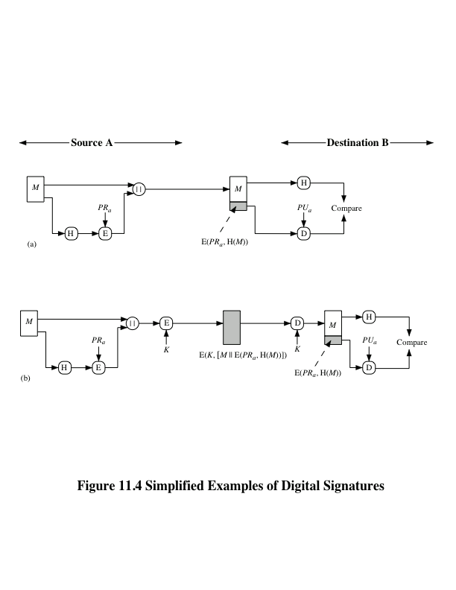

Notes:
Figure 11.4 illustrates, in a simplified fashion, how a hash code is used to provide
a digital signature.
a. The hash code is encrypted, using public-key encryption with the sender’s private
key. As with Figure 11.3b, this provides authentication. It also provides a
digital signature, because only the sender could have produced the encrypted
hash code. In fact, this is the essence of the digital signature technique.
b. If confidentiality as well as a digital signature is desired, then the message
plus the private-key-encrypted hash code can be encrypted using a symmetric
secret key. This is a common technique.

Slide 22
Summary
Applications of cryptographic hash functions
Message authentication
Digital signatures
Other applications
Requirements and security
Security requirements for cryptographic hash functions
Brute-force attacks
Cryptanalysis
Secure hash algorithm (SHA)
Notes:
Chapter 11 summary.

